Slide 1
What type of superhero do you want on your dev team?
Aaron Deming
Applications Development Manager
Buildertrend

Slide 2
What is my experience with superheroes and dev teams?
(aka why am I qualified for this talk?)

Slide 3
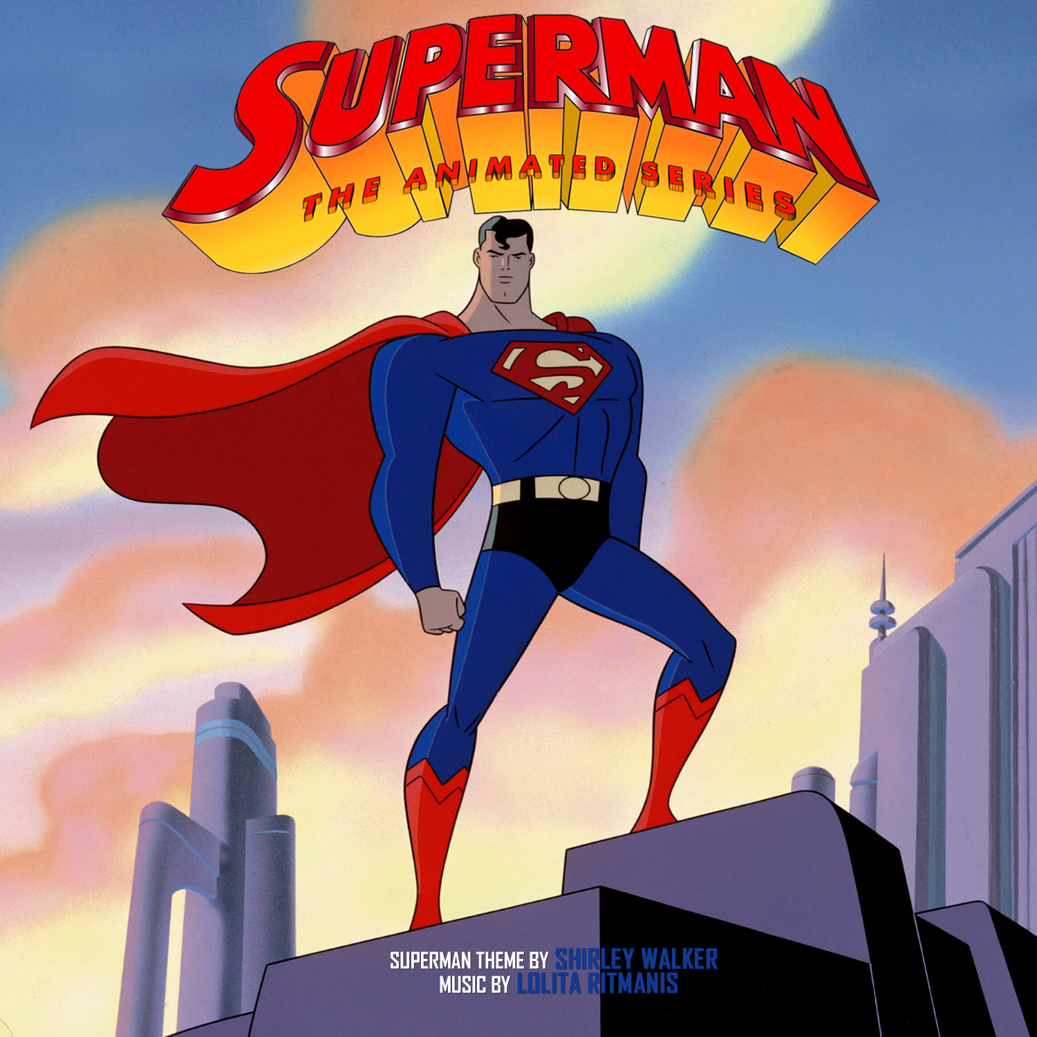
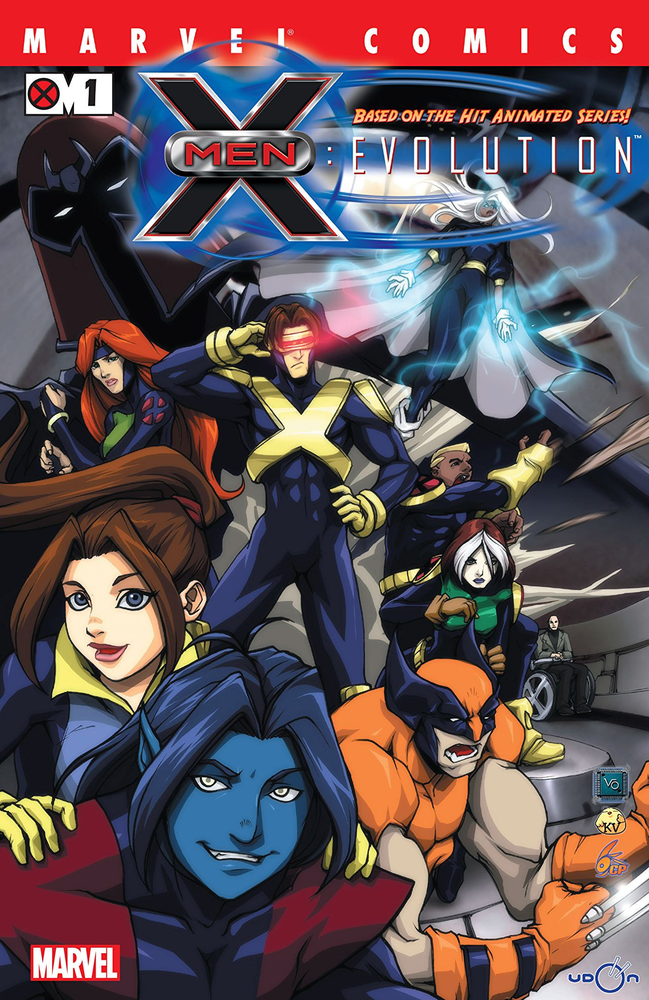
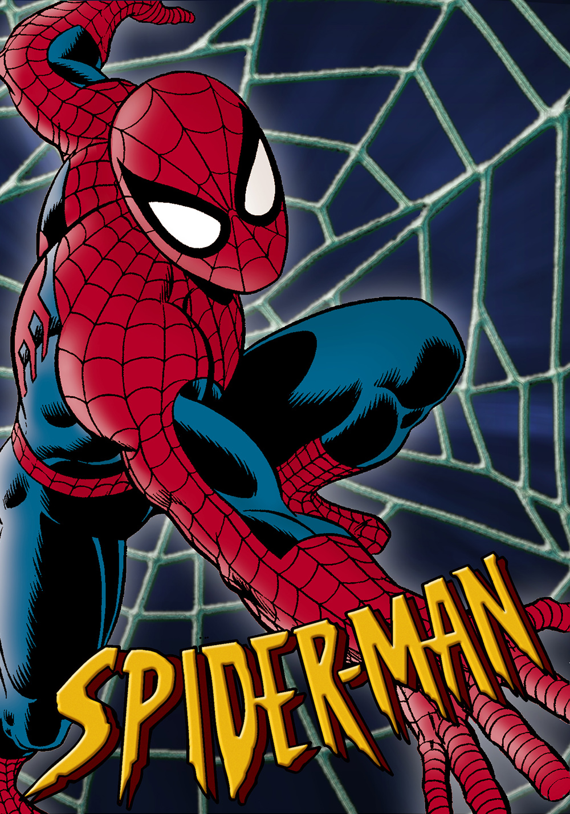
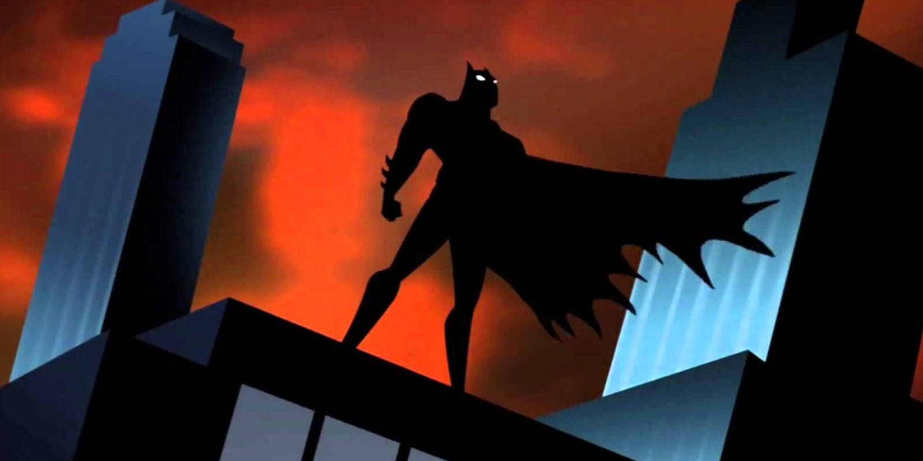
Childhood Nerd

Slide 4
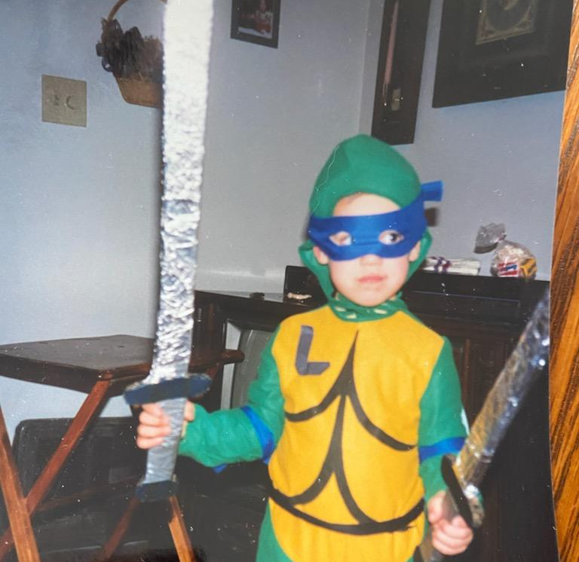
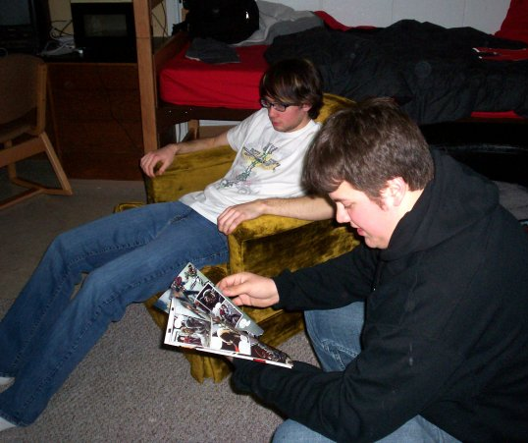
Childhood Nerd

Slide 5
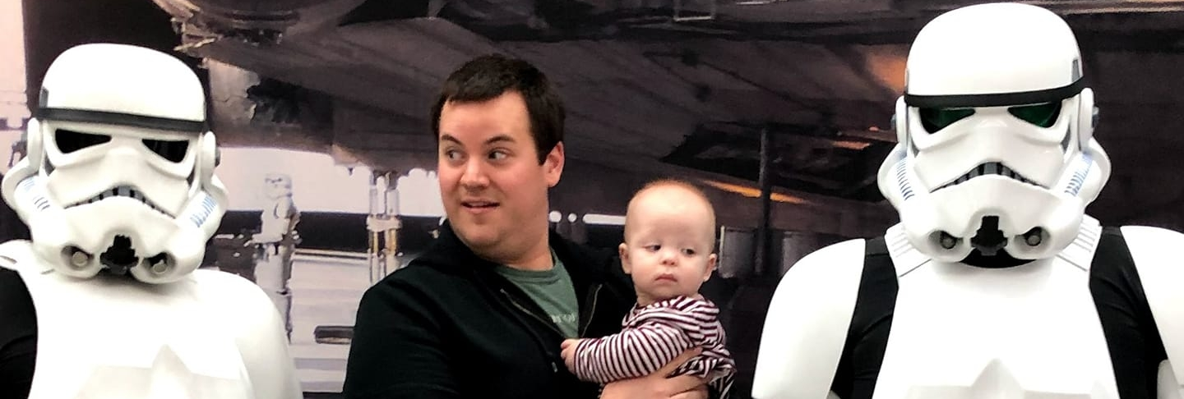
Proud Nerd Dad

Slide 6
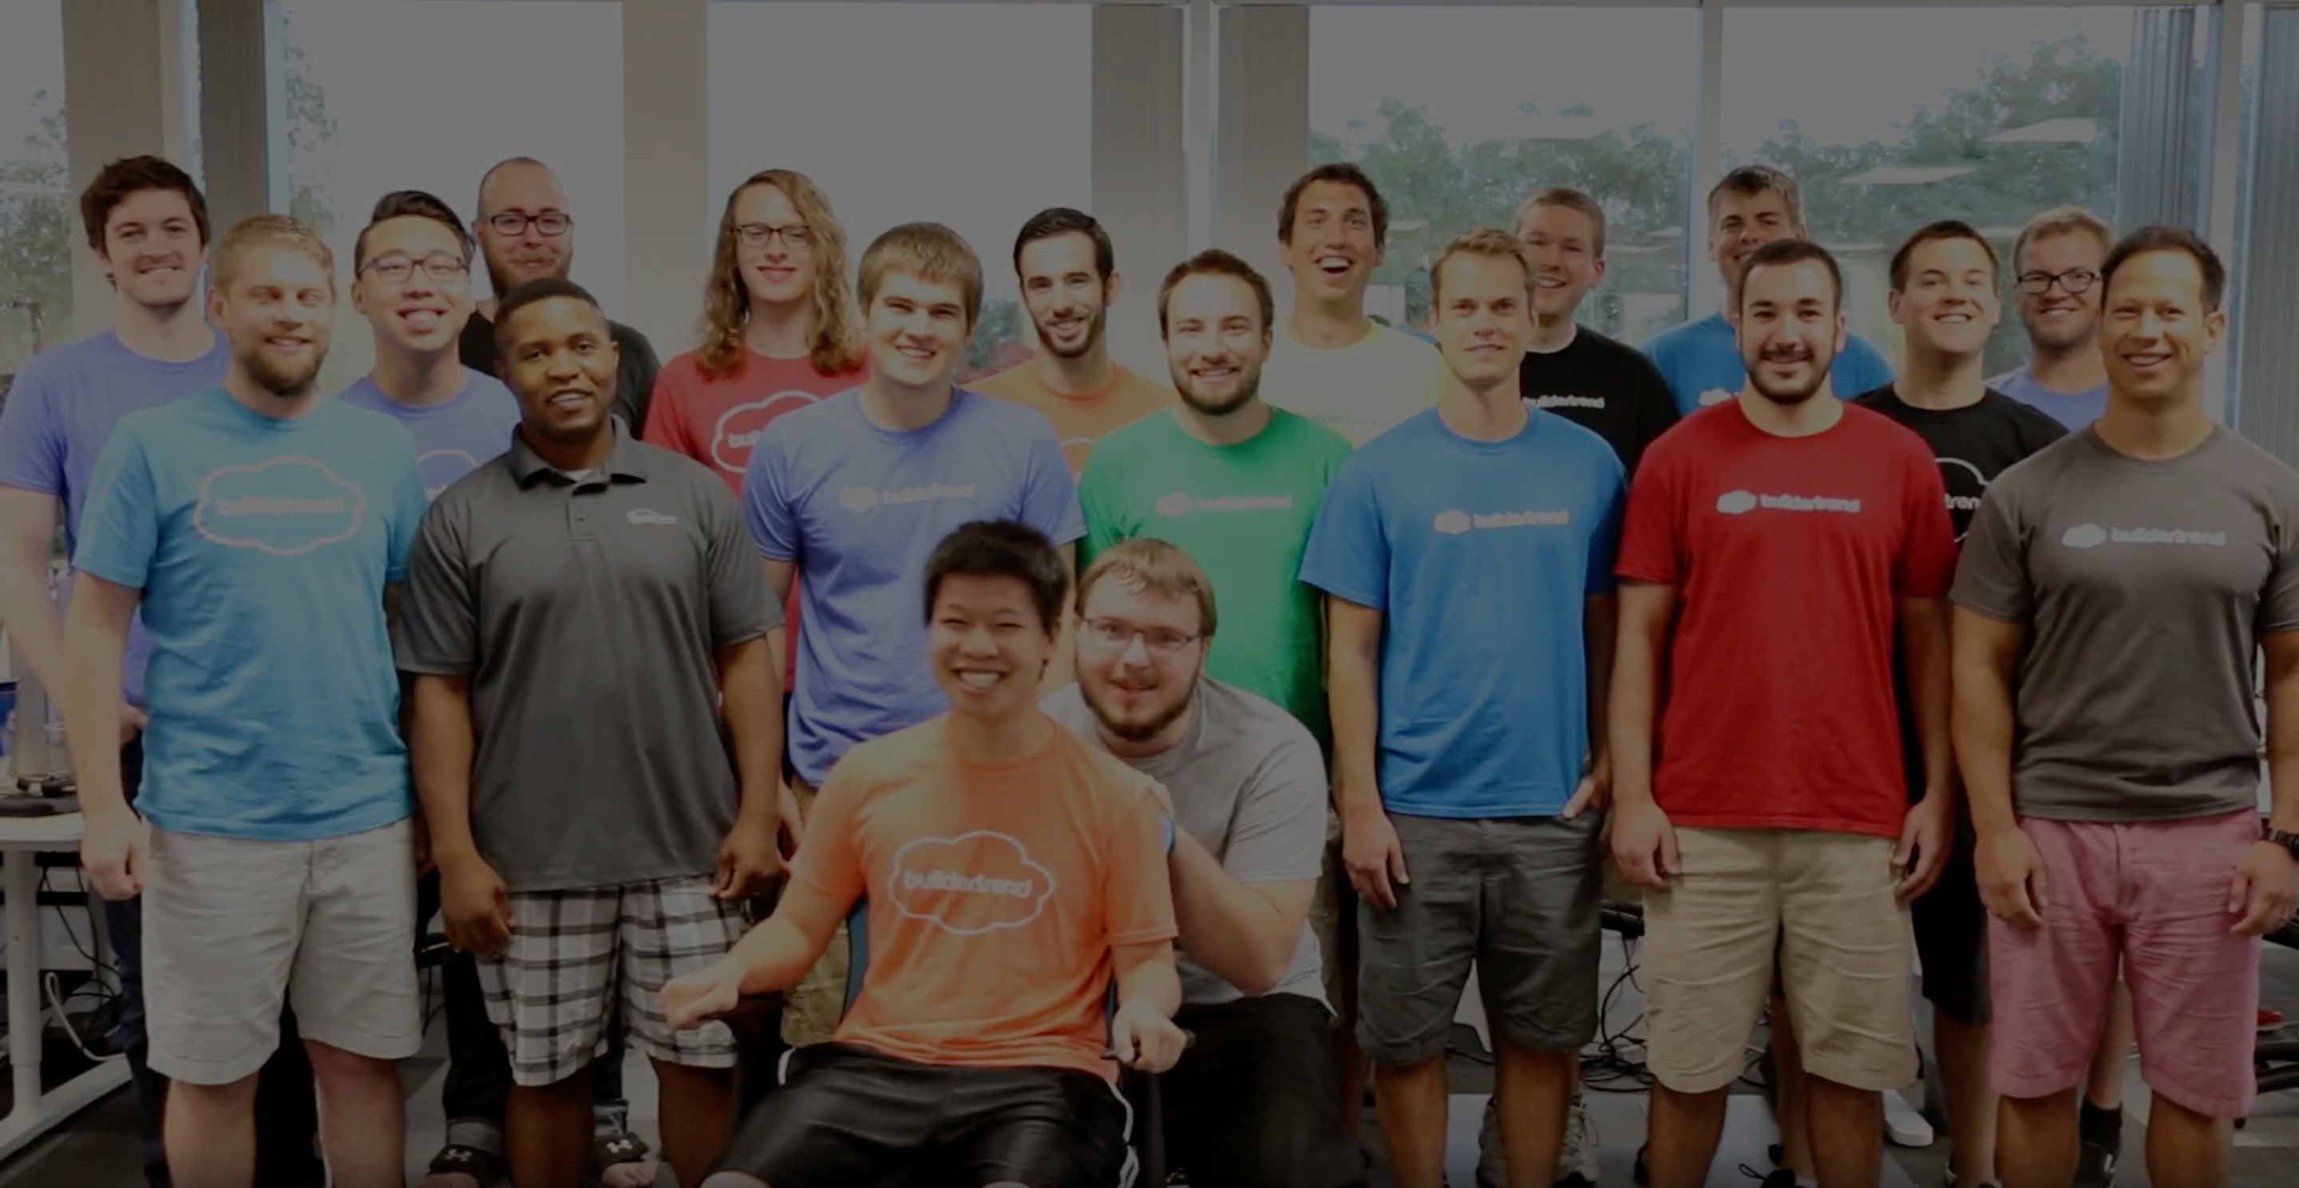
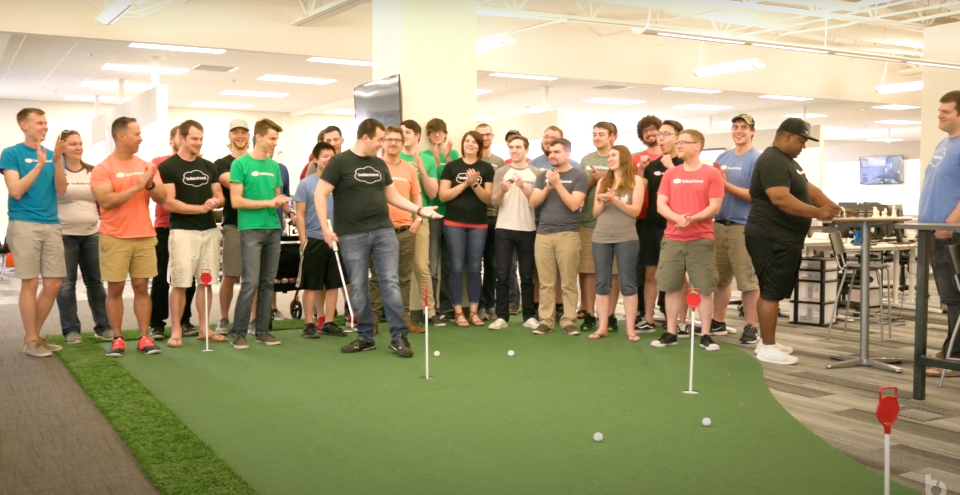
My History with Buildertrend
2016: 1 of ~20 developers
2017: Team Lead, oversaw 1 of 5 teams, 4-person teams
2018: Team Lead, oversaw 1 of 7 teams, 8-person teams
2019: Trainer, oversaw onboarding of ~50 new developers
2020: Trainer, oversaw dev team of all new developers
2021: Manager, overseeing 3 dev teams

Slide 7
How does this help?
Growth!
20 developers (150 employees) to ~70 developers (~800 employees)
Acquired 20 developers this year from CoConstruct
Adjust to Scale
Dev teams changed from area focus to project focus
Tried teams with different level of skill
Dev only to integrated product and QA
I’ve seen the experiments; what works and what doesn’t

Slide 8
Team Pitfalls
Too many developers on one team
Early career devs grouped together on the same team
Blind leading the blind
Team leads asked to do multiple roles
Too many projects at once
Often 1 project per dev; team lead had a lot to focus on

Slide 9
Comparing Developers to Superhero Archetypes

Slide 10
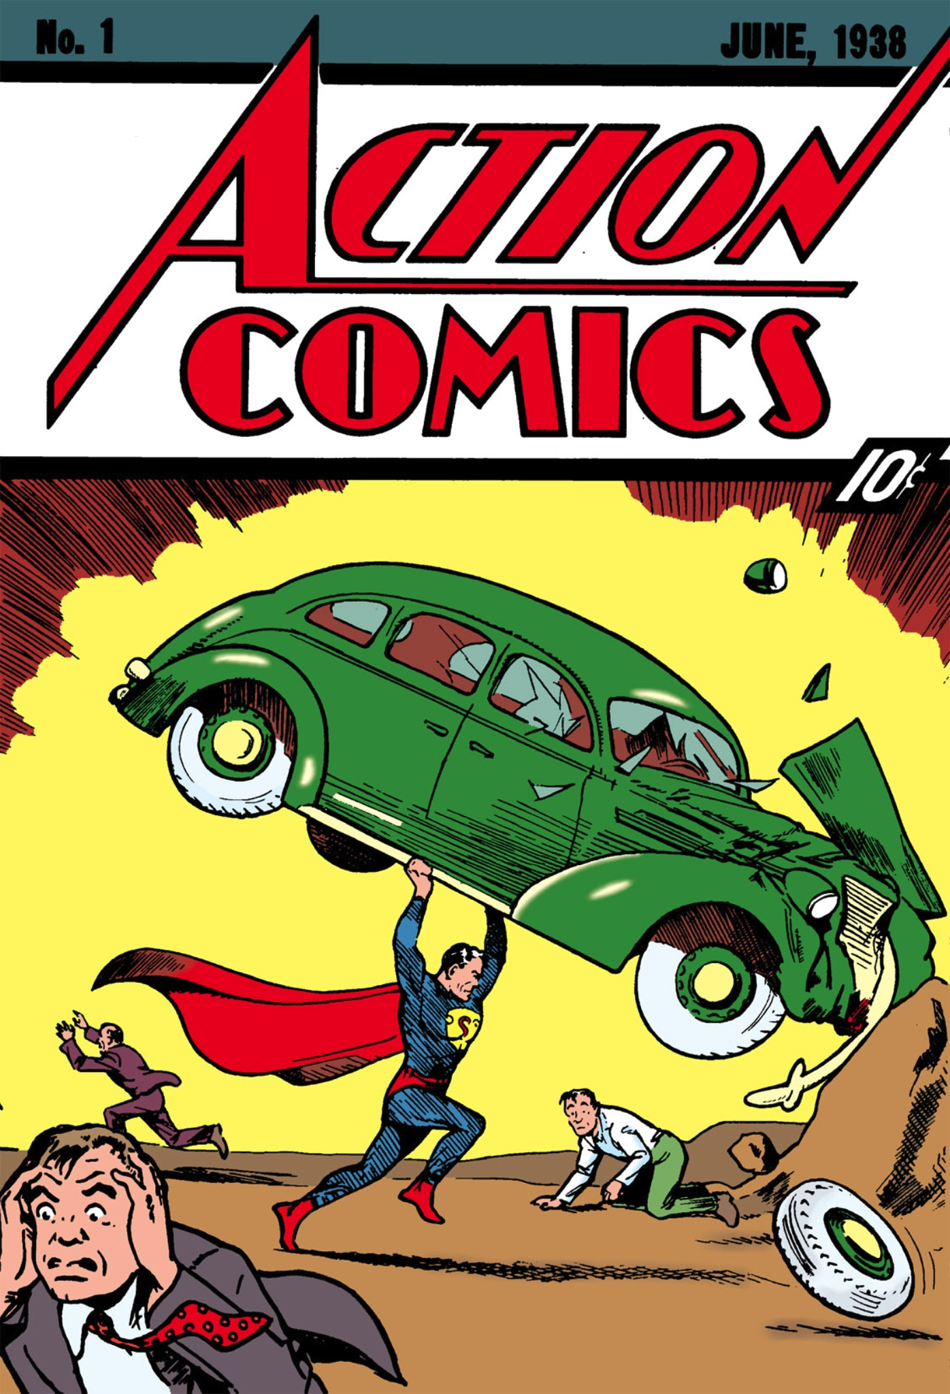
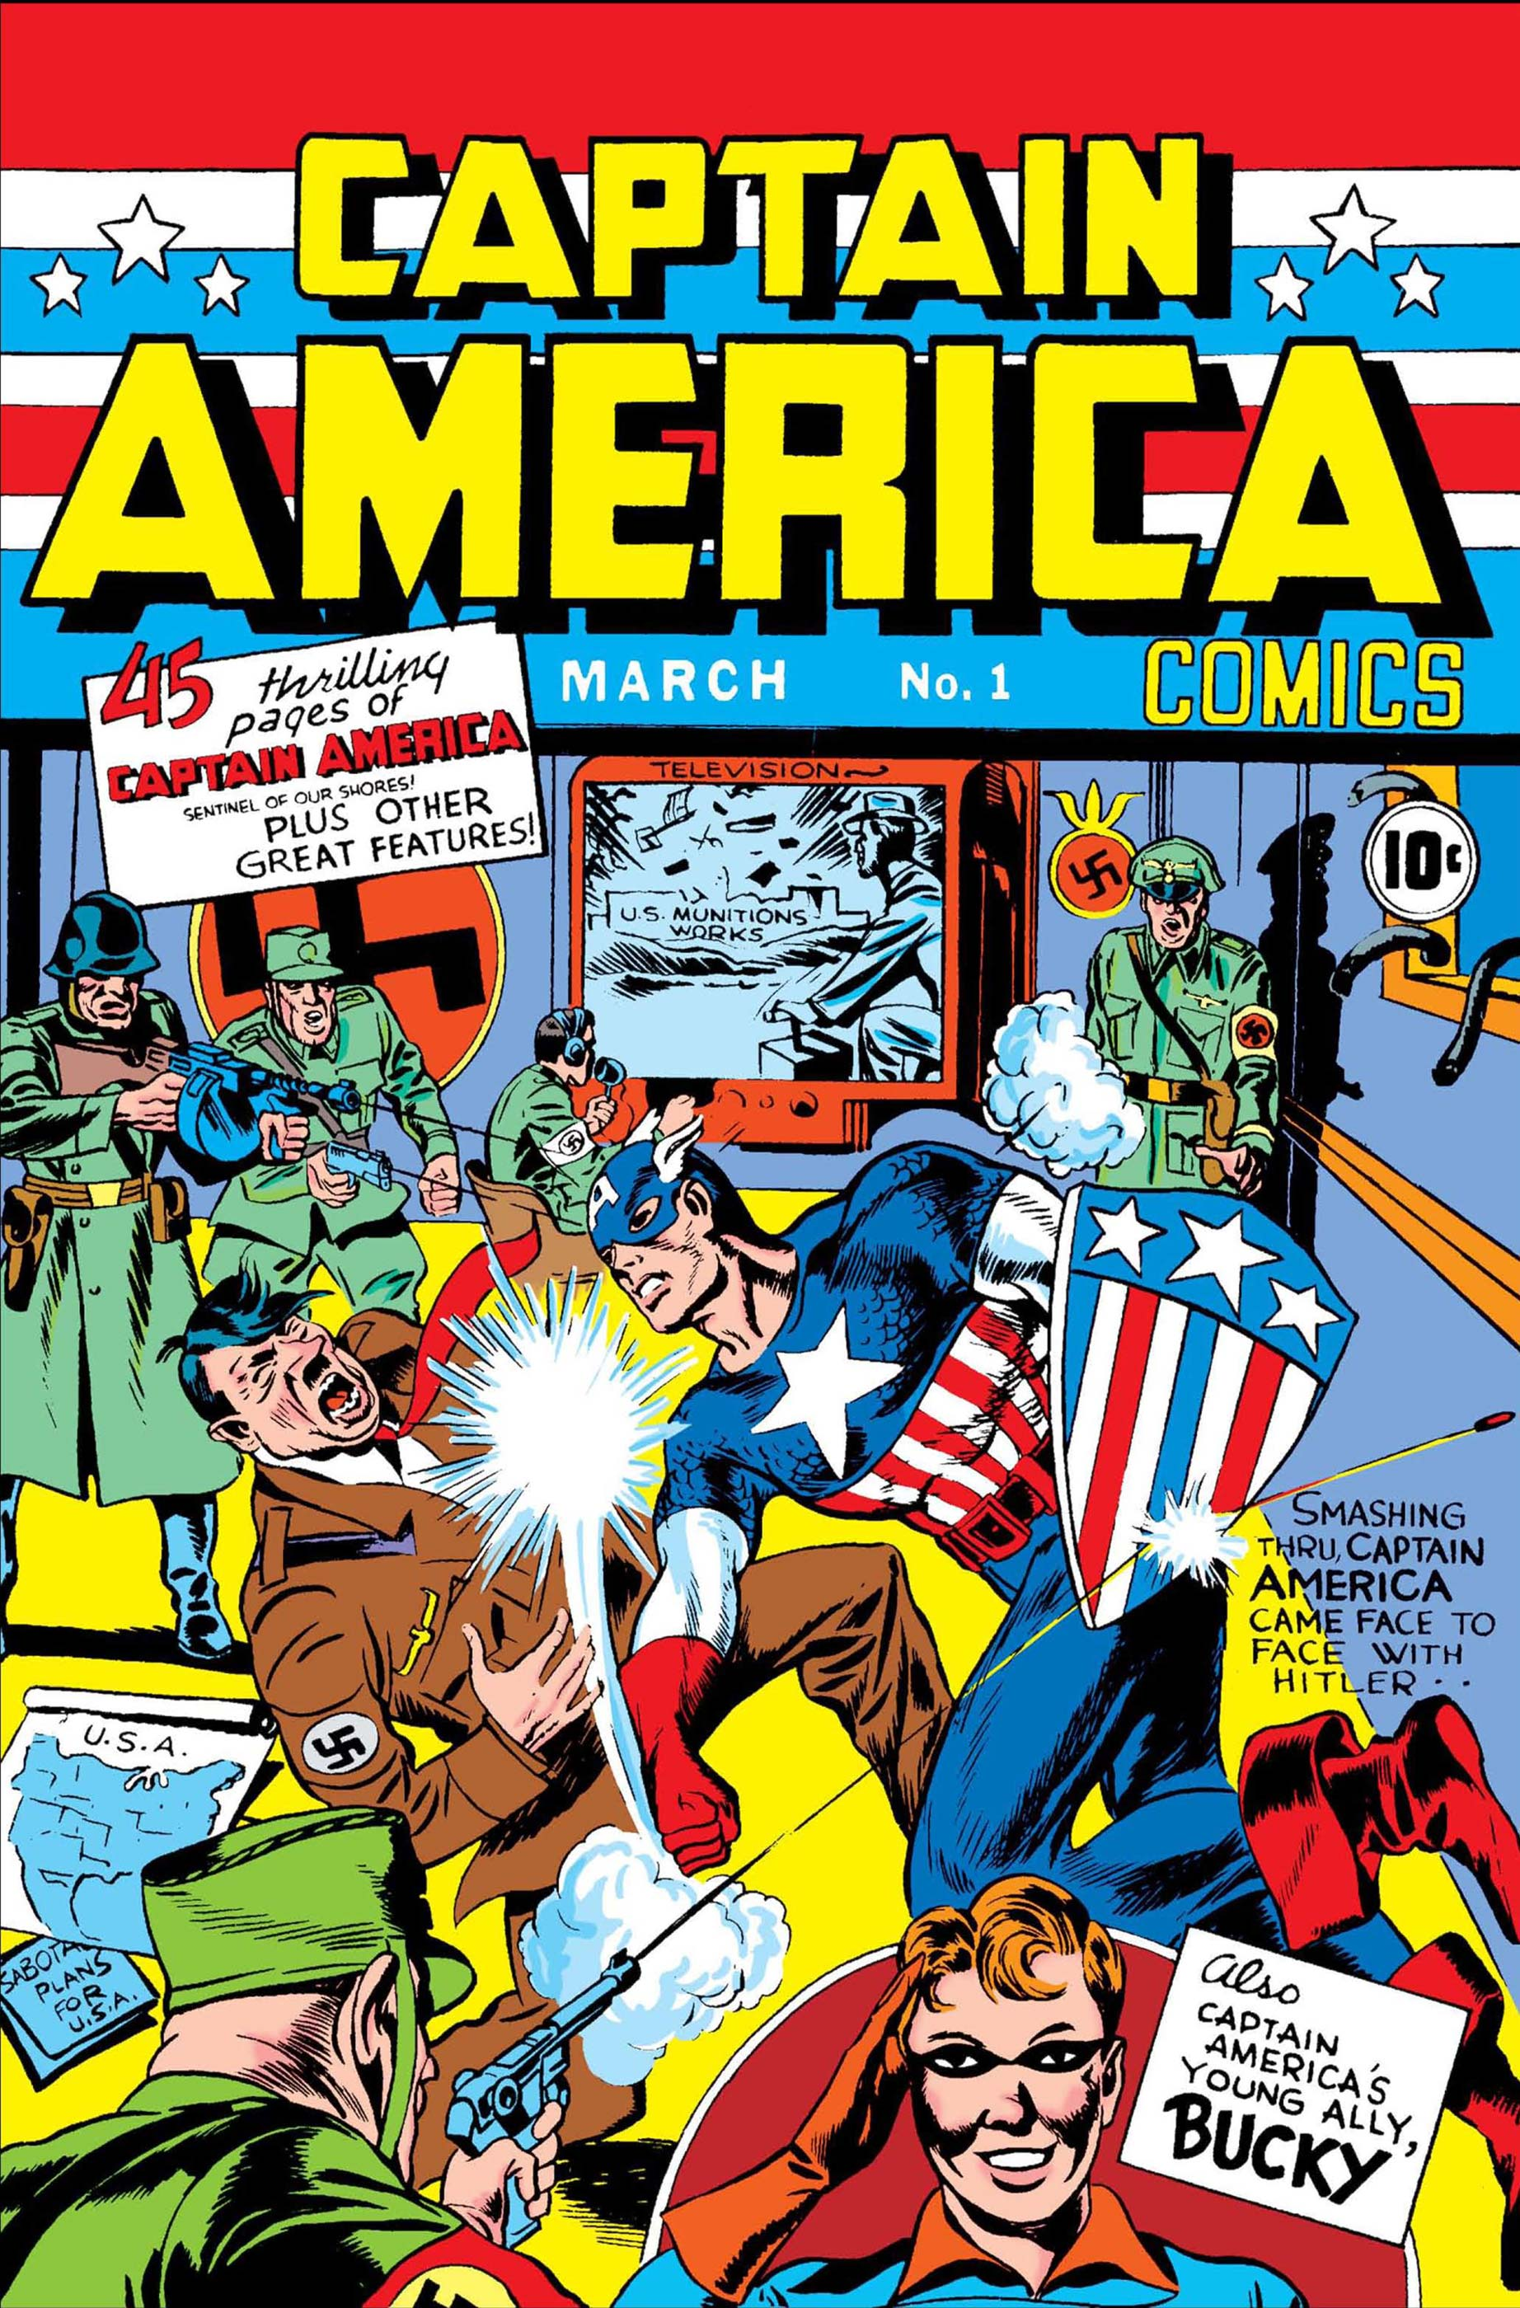
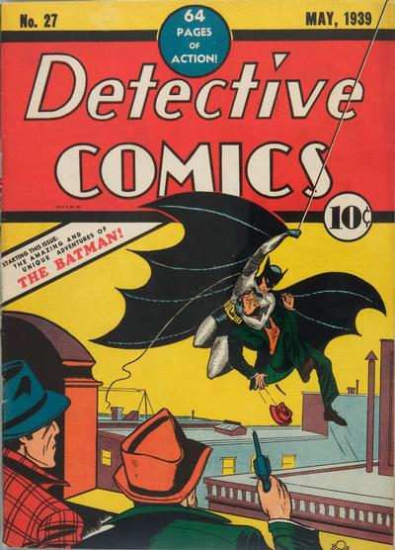
How can we use Superheroes to form strong teams?
Developers can often align with archetypes
We can use the last 100 years of Superhero stories as a basis for good dev teams
How we can work together to "save the day”

Slide 11
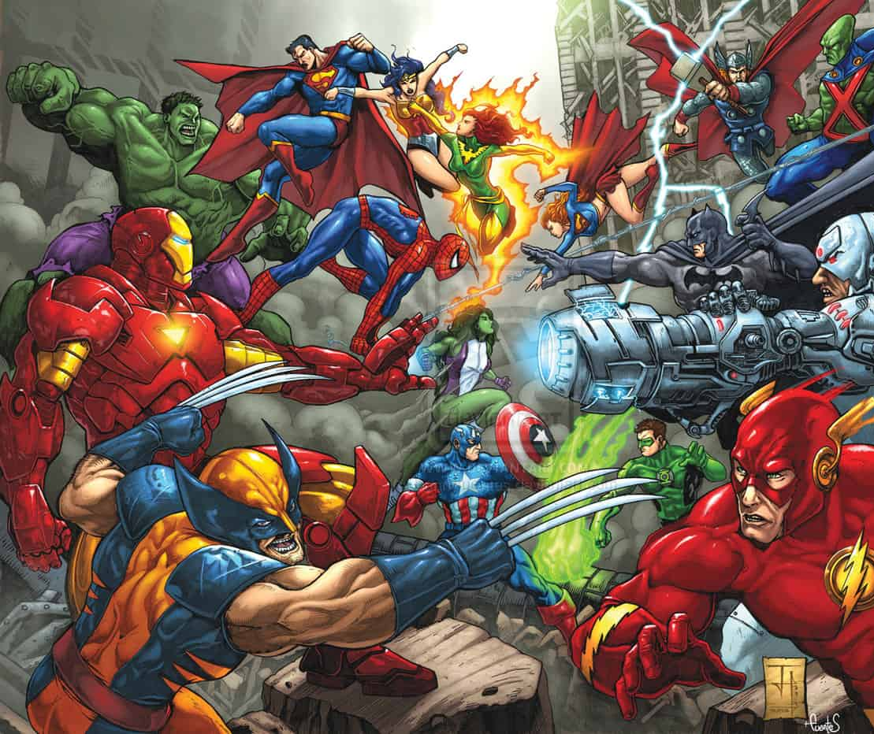
What won’t be covered?
Why Marvel is better than DC
Why Superman is subpar
How people are more complex than their superhero archetype
Intentionally simplifying to help form strong teams

Slide 12
The Heroes

Slide 13
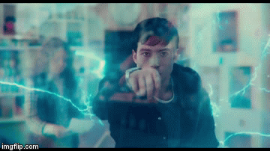
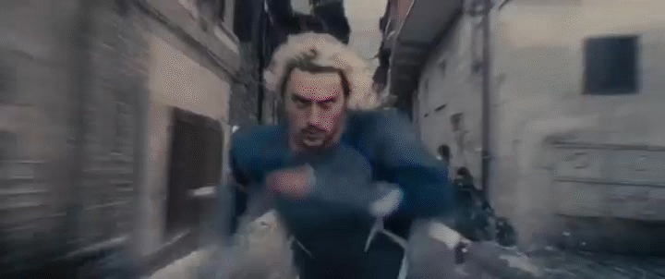
The Speedster
Solve problems fast but leave a trail of destruction in their wake
Tend to focus on speed over quality
Can be coached to turn “speed over quality” into “quality with speed”

Slide 14
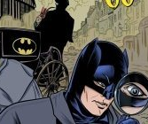
The Master Detective
Strives to solve all problems themselves
Often abrasive and thinks they work best alone
Has contingencies for the failure of the teammates

Slide 15
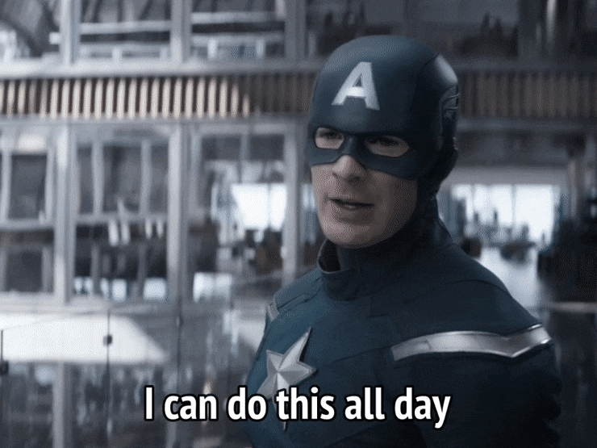
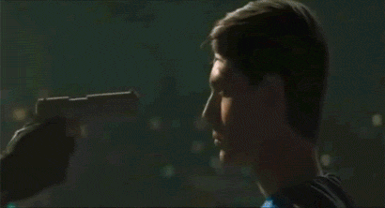
The Eagle Scout
Understands, and follows, all processes ”to a T”
Code reviews expectations are typically higher for these individuals
Sometimes even to the point of trivial formatting issues ending up as blockers

Slide 16
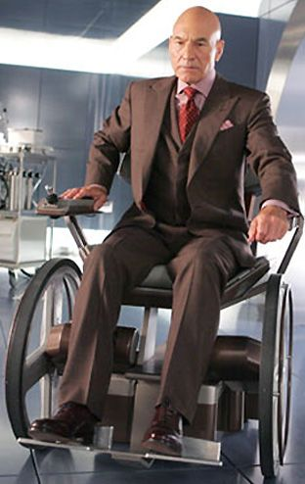
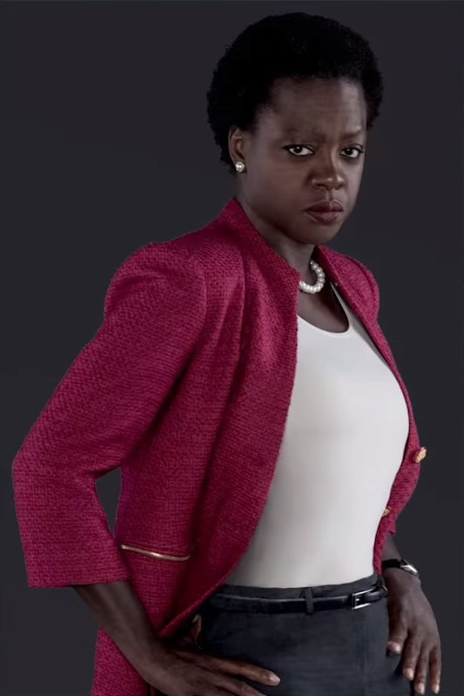
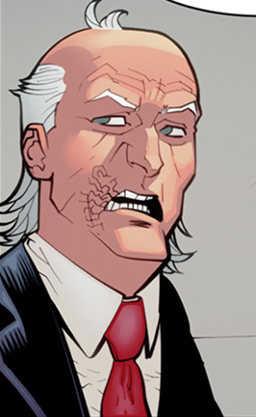
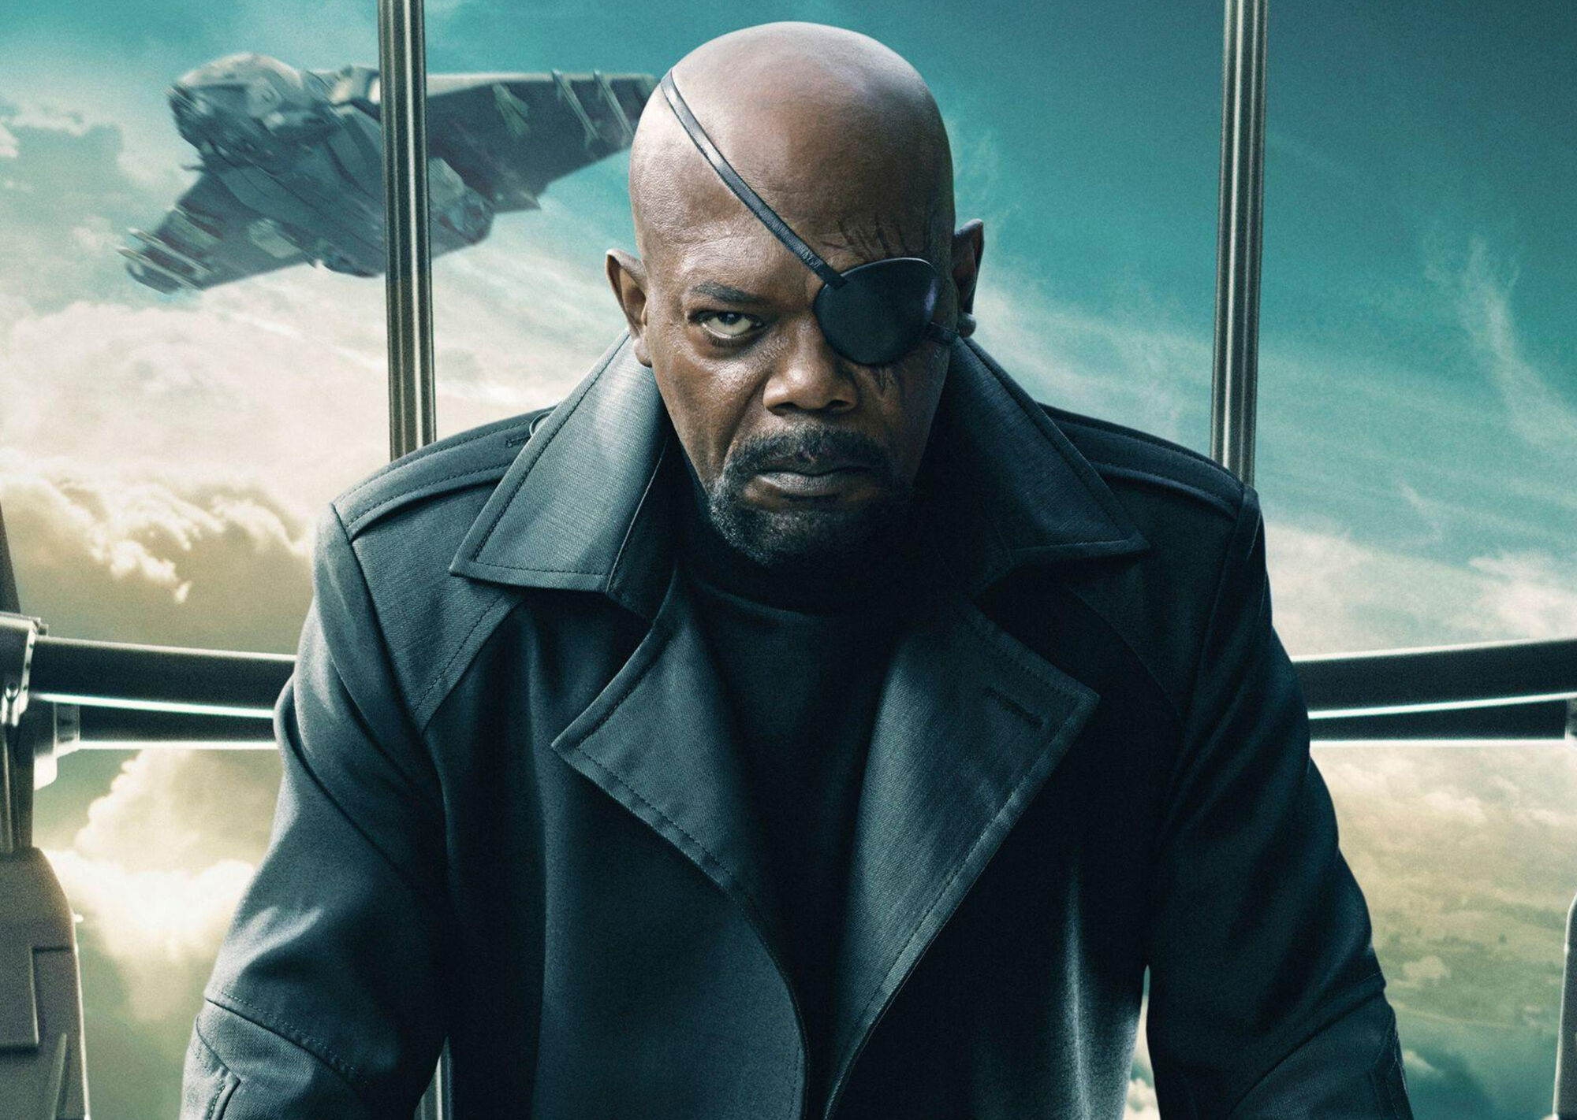
The General
Might not do the "hands on" work themself
Employs various strategies to get people on track
Not always good... Aka the bomb collars for The Suicide Squad
Might fall under the side of micromanagement

Slide 17
The Villains

Slide 18
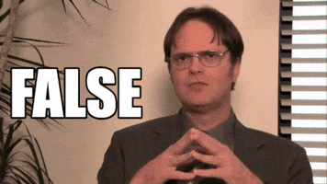
Who are the villains that developers go up against?
QA
The Client
Other teams within the org

Slide 19
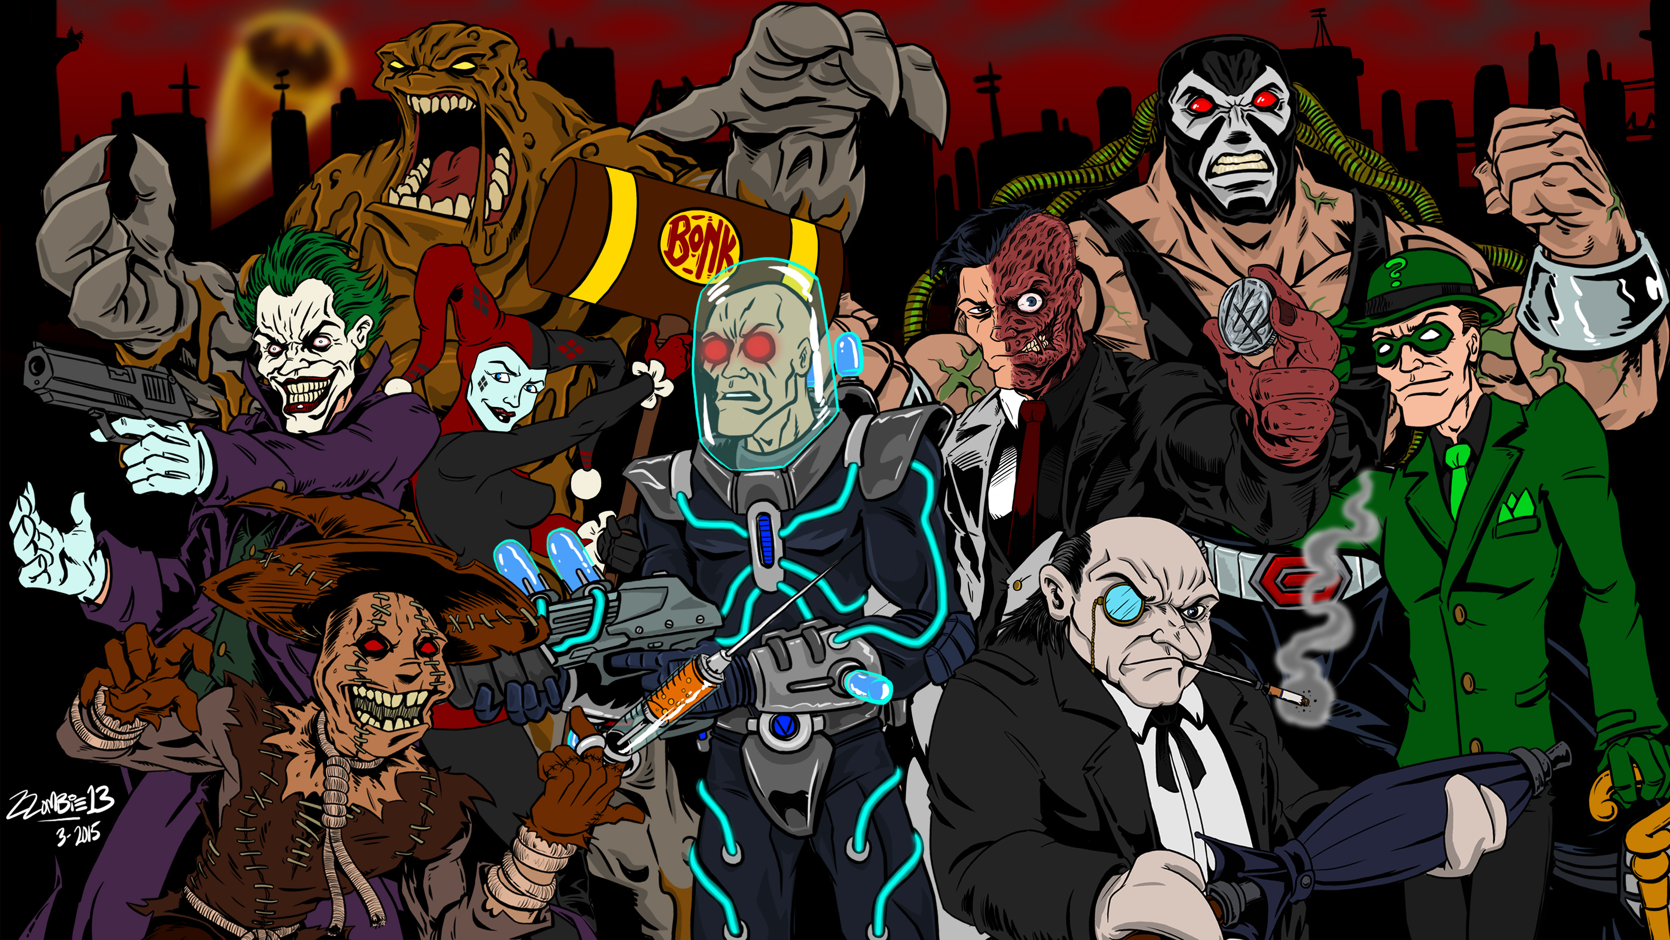
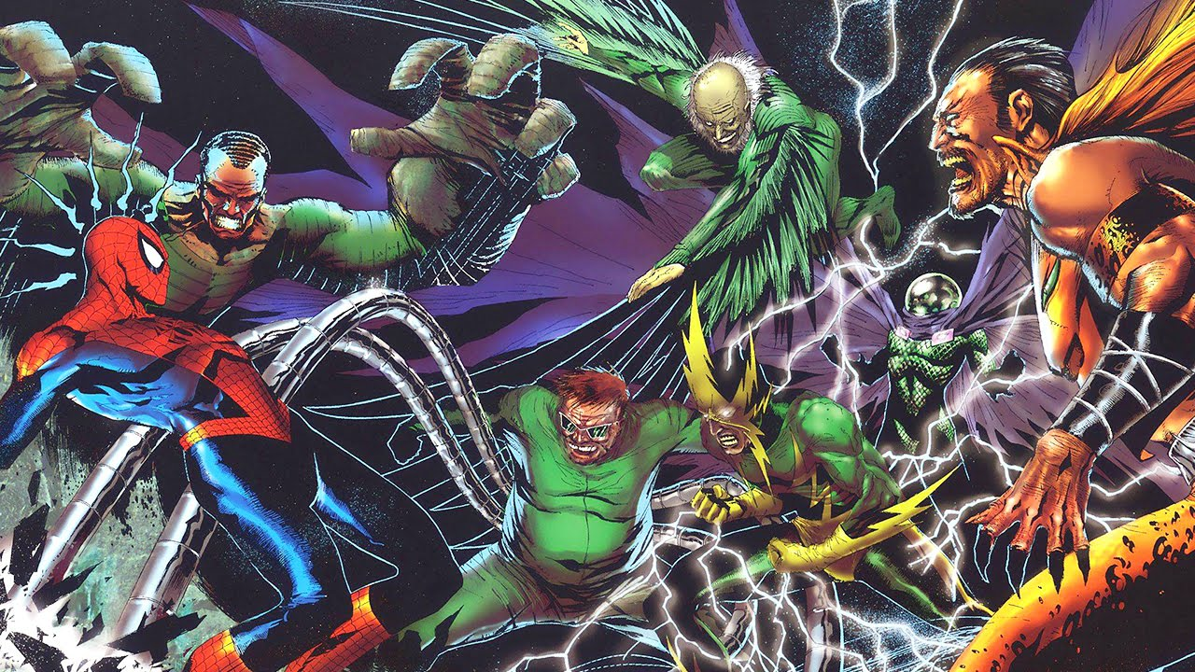
The Real Villains!
Low-level criminals: enhancements to existing features, day-to-day responsibilities
Rogue’s Gallery: Bugs, Refactors, Code Health
Arch-Nemesis: Difficult to enhance code

Slide 20
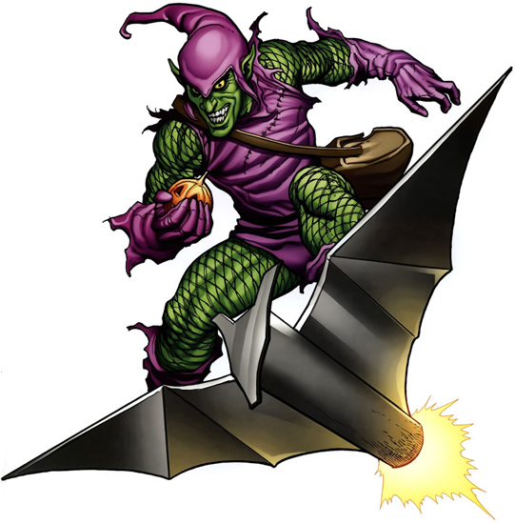
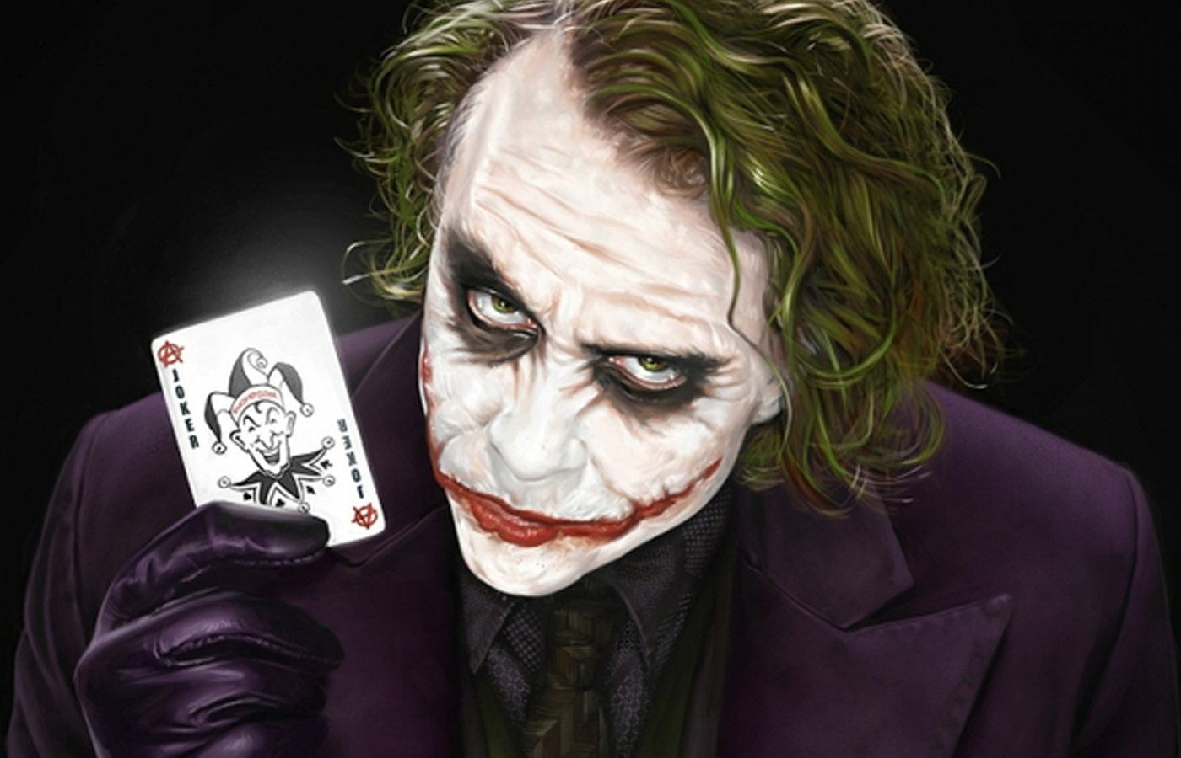
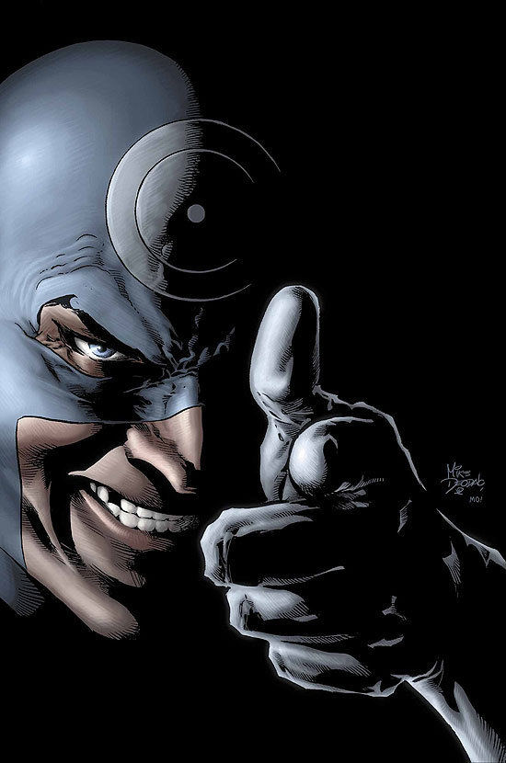
Origin of the Arch-Nemesis
Neglecting code health in favor of speed
Sacrificing automated tests
Writing code without a solid plan or foundation
Requirements shifting significantly during development cycles

Slide 21
The Team
What should you be looking for when putting the “heroes” (aka devs) together

Slide 22
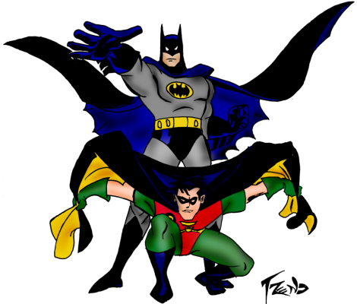
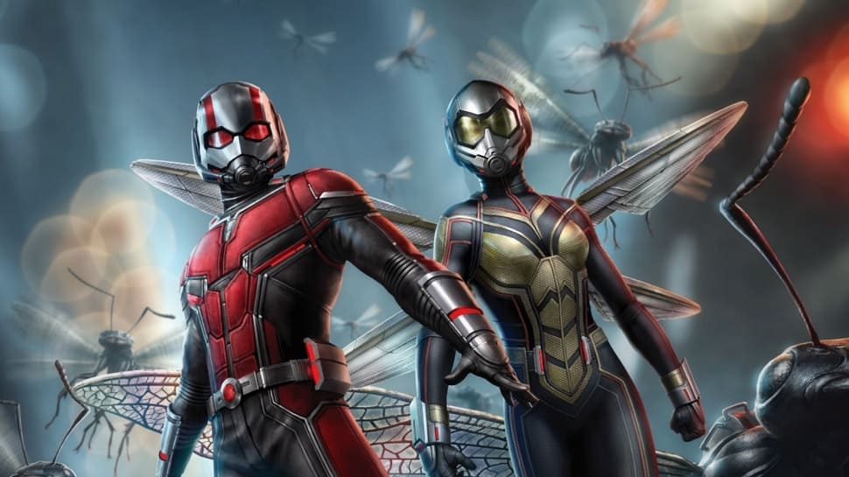
Dynamic Duo
Pair programmers
One often takes a leadership role, despite a strong partnership
Can be hard to work with someone else
Ex: Robin (Dick Grayson to Jason Todd)

Slide 23

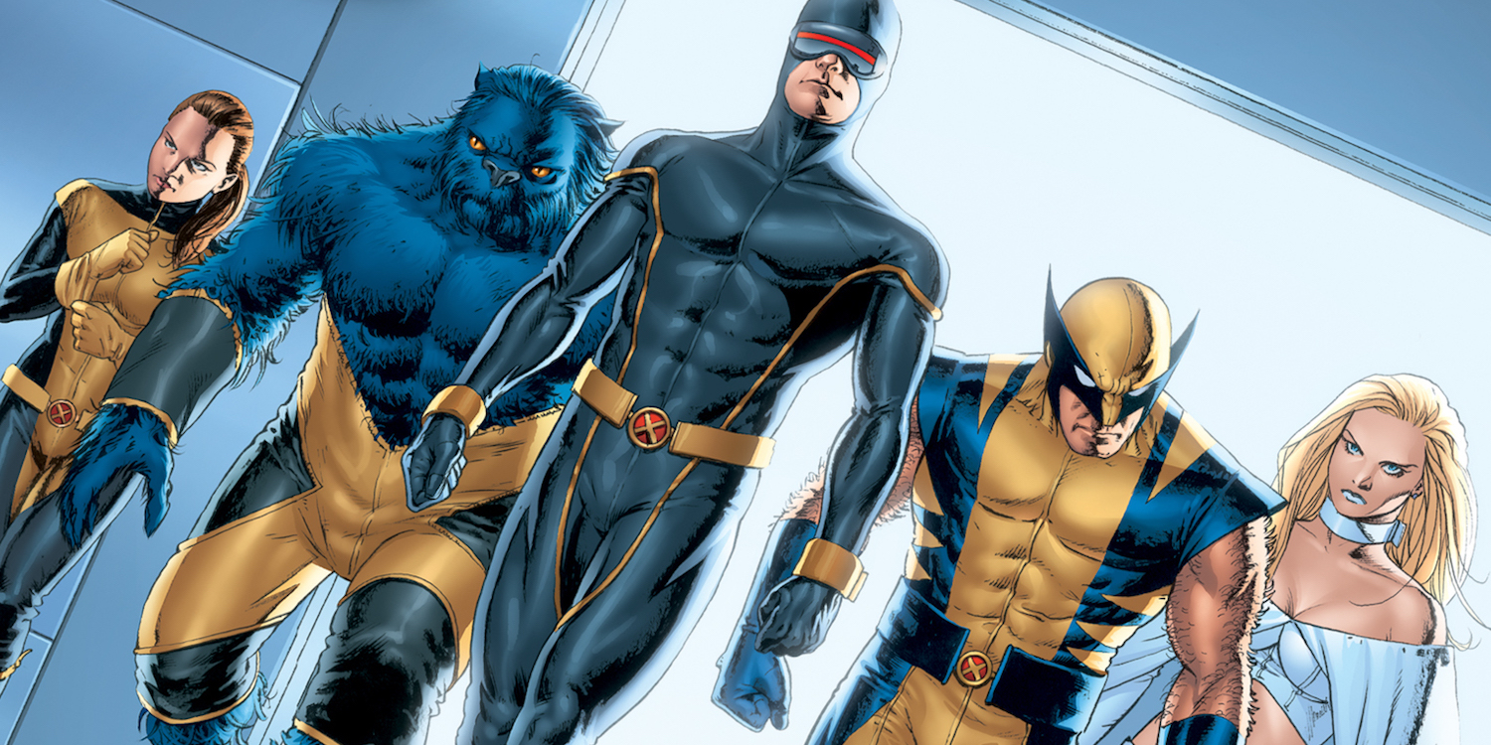
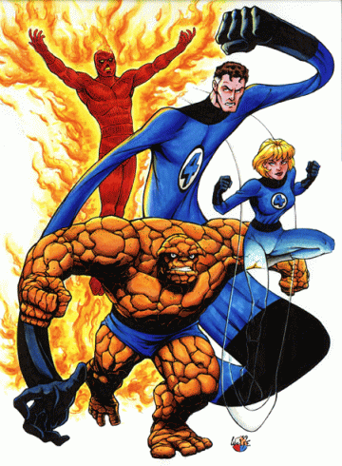
Roommates
Similar backgrounds
Essentially live together; work late nights
Leader shows bias towards team
This Photo by Unknown Author is licensed under CC BY-SA

Slide 24
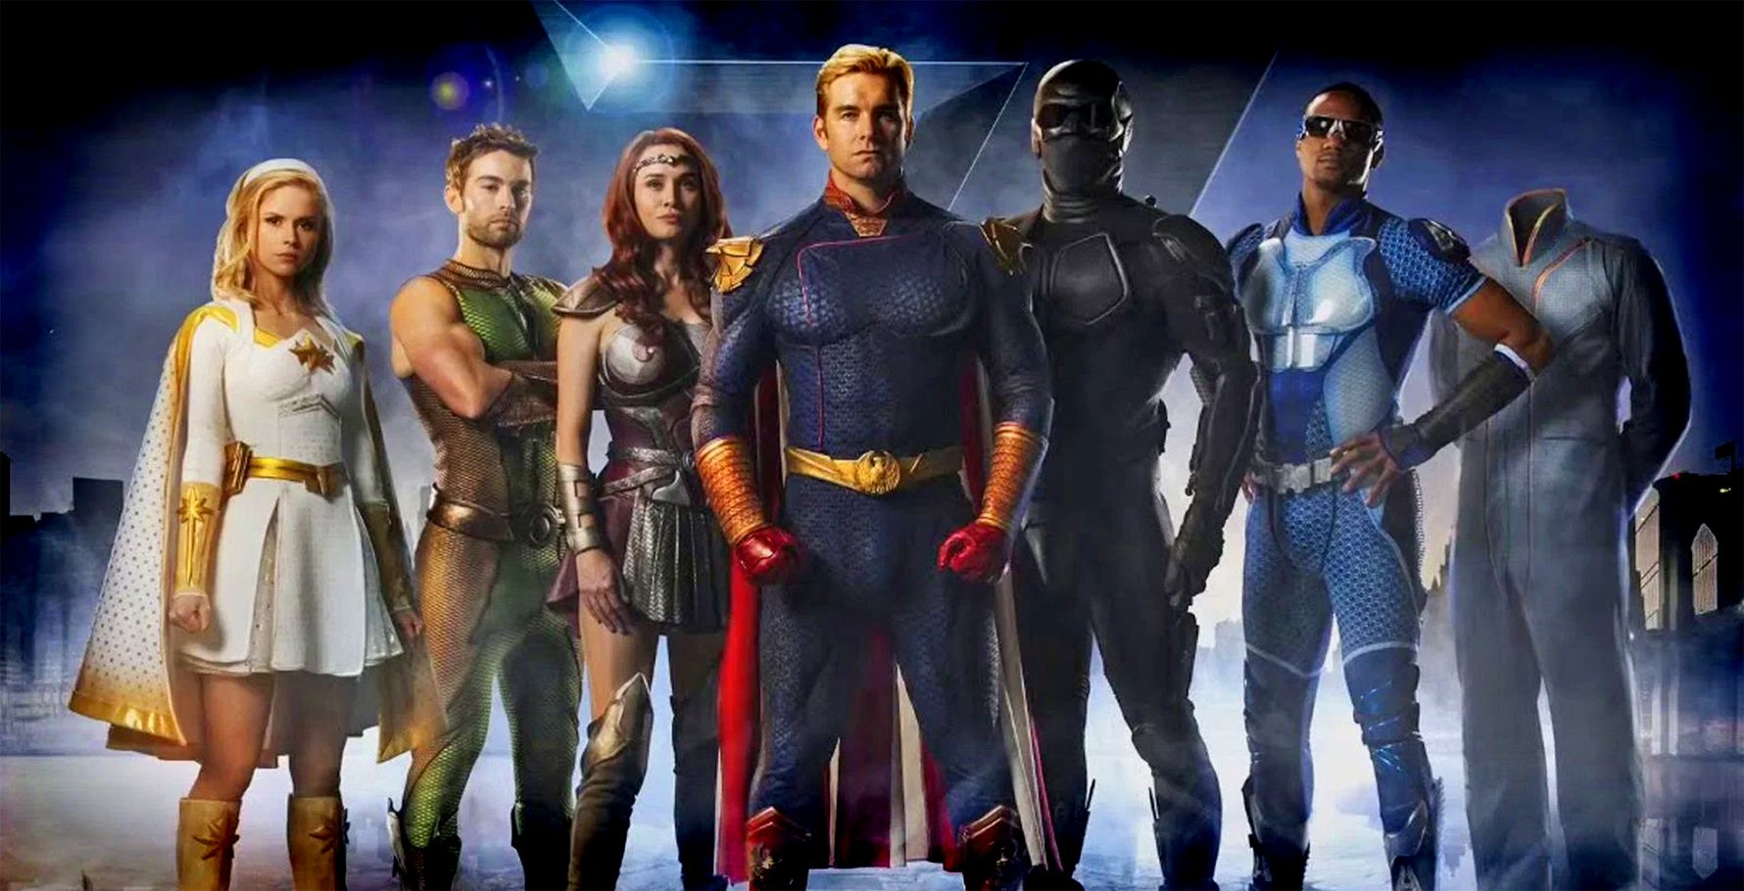
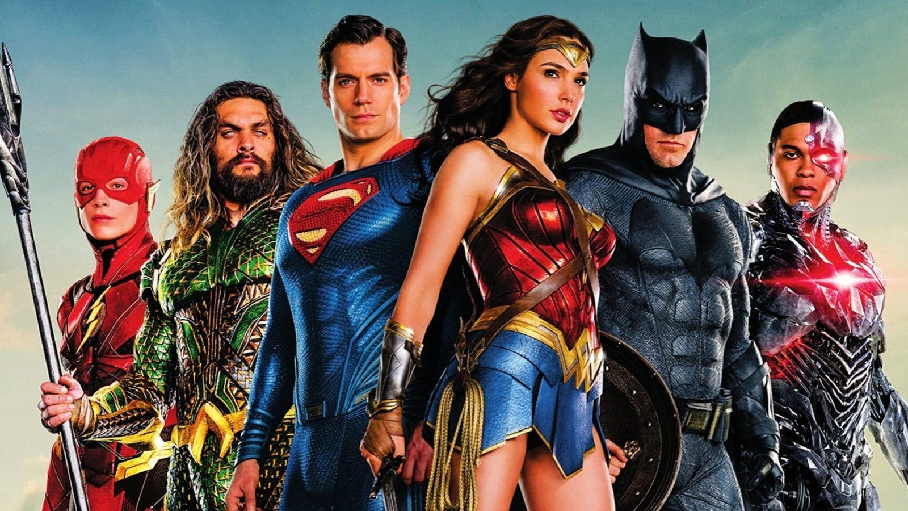
Pantheon of Gods
Every team member is overpowered; senior+ developers
Work only on what they believe is best

Slide 25
What do we need for an ideal team?
Team come together when a specific problem needs to be solved
Leader pushes project quality ownership
Strengths of team members reinforced; weaknesses cancelled out
Mentorship so that everyone is growing
Junior members become senior
Senior members take on more leadership and responsibilities

Slide 26
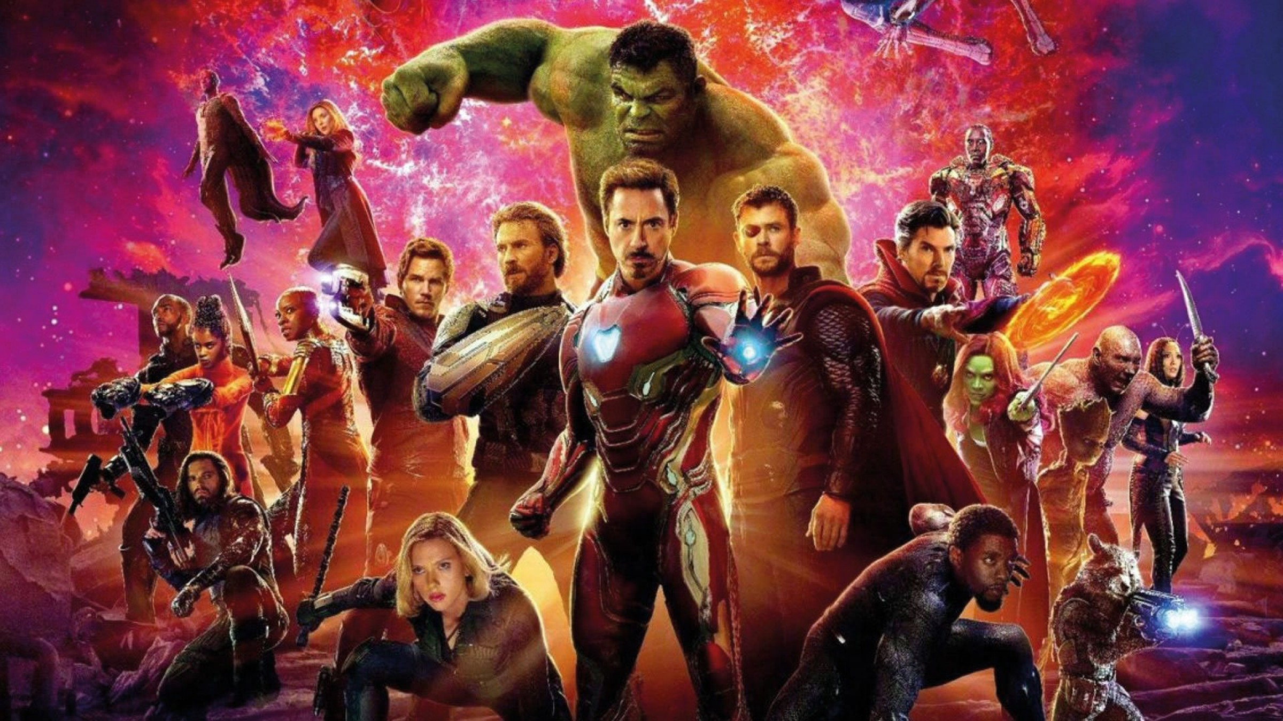
The Avengers
Multiple teams that work together
Ex: Avengers: Infinity War
More common in the comics
Diverse backgrounds
Ex: Uncanny Avengers
Team focus may vary, but is known by all members
Ex: Avengers on Titan to stop Thanos; Avengers on Earth to protect Vision
Ex: Mighty Avengers take on low-level criminals, Uncanny Avengers work to improve Human/Mutant Relations

Slide 27
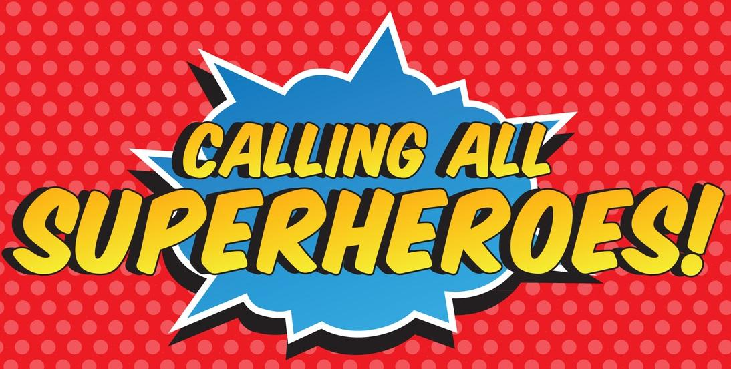
Conclusion
Think about developer strengths and weaknesses
Feel free to use other metaphors
Group them together to…
... solve specific problems
… support strengths
… balance out weaknesses
Experiment to learn and grow

Slide 28
Where can you find me?
LinkedIn (linkedin.com/in/aaron-deming/)
Twitter (@aaron_deming)
Github (ademing)
Check out buildertrend.com to learn more about Buildertrend

